Slide 1
TRB International Partnership Meeting
Connected Road Surface Measurements
Wednesday January 8, 2025
Jan-Erik Lundmark
Konfidentialitet: Nivå 1-extern

Slide 2
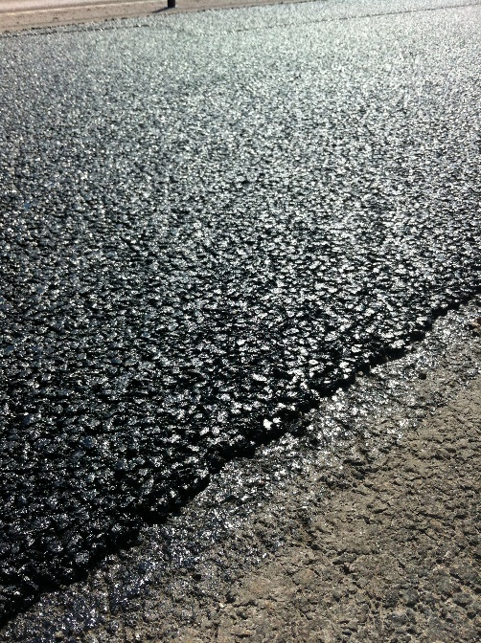
Outline
Swedish Road Network
Background
Trafikverkets needs
Procurement process

Slide 3
Swedish Road Network
100 000 km (80 000 km paved roads)
  about 5 % is High Traffic Roads > 7 500 ÅDT
  over 50 % is Low Traffic Roads < 2 500 ÅDT
  Big variation in climate from South to North (1 600 km)
Short paving season for quality pavements ( May-October)
Trafikverket have maintenance focus last years on high traffic roads and important roads for the industry. But from 2025 we will include all roads.
Budget pavement maintenance 400 million $ 2025
Total production of asphalt 1,5 million MT
Notes:
HMA=Hot Mix Asfalt

Slide 4
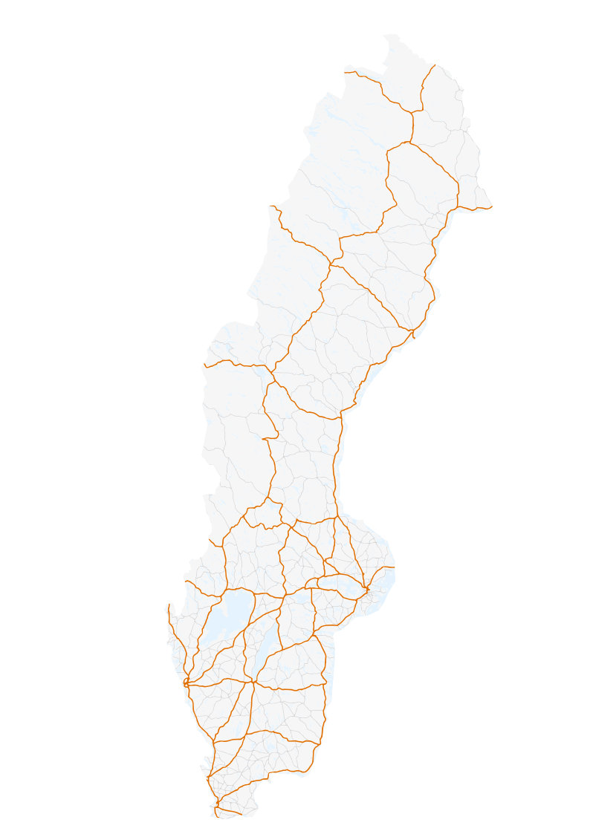
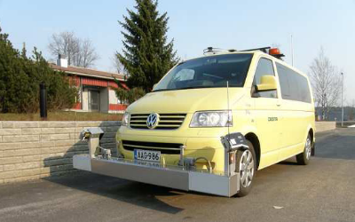
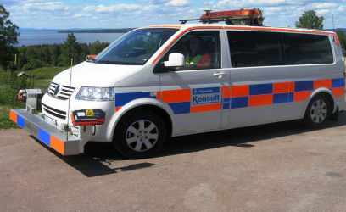
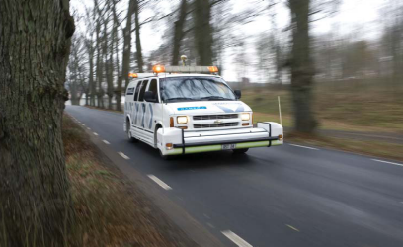
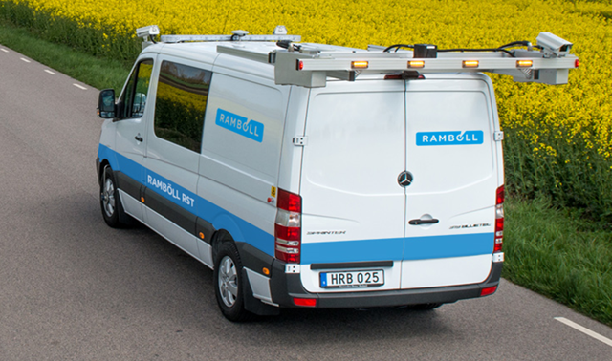
Background
Trafikverket has a long tradition of high quality pavement condition measurements.
Main roads annually
Other paved roads biannually
75 000km/year
We have a well developed system for data usage in pavement planning.
PMSv4 - Start (trafikverket.se)
Pavement and condition data since 1987.

Slide 5
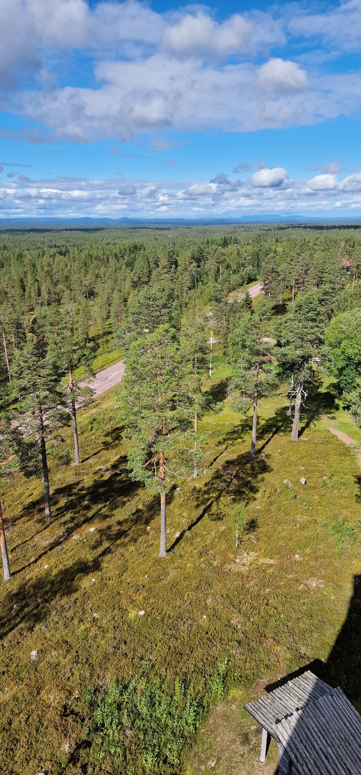


But!
We need better data on the condition of our pavements between the regular measurements
Notes:
Measuments are typically done when the pavement is at its best condition.

Slide 6
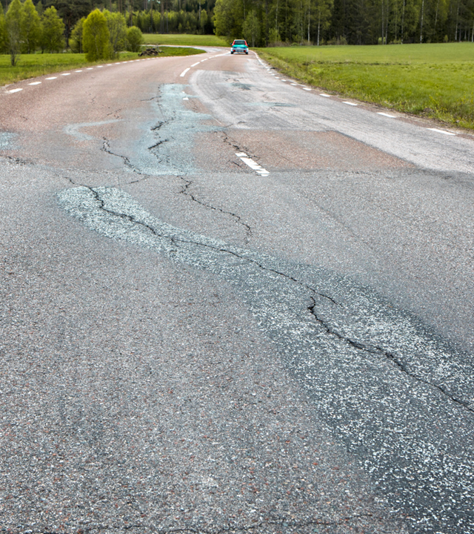
Trafikverket’s needs
Frost heave damage
Pavement damages caused by uneven frost in the road. Usually most severe during late winter/early spring.

Slide 7
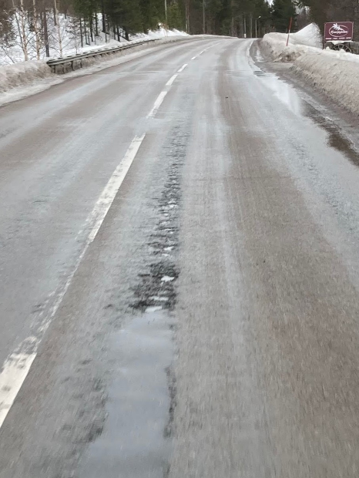
Trafikverket’s needs
Surface damage / ”Winter damage”
Raveling/ stone loss caused by frost-thaw cycles, water, studded tyres etc.

Slide 8
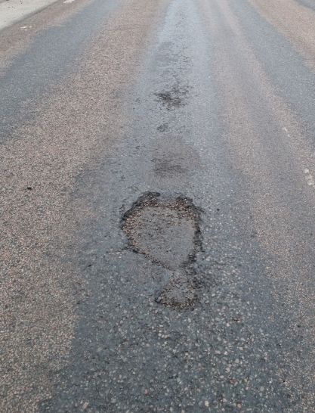
Trafikverket’s needs
Acute damages
For example pot holes or other damages that may affect accessibility and road safety.
Connected measurement will be a complement, not a substitute!

Slide 9

Procurement process
Development, demonstration and validation
Purchase and delivery of service
Procurement
(negotiated procedure)
Phase 1
Qualification
Phase 2
Bidding and negotiation
Phase 3
Delivery of the service
Phase 4
Stage 1 Establishment/
development of the service and verification
Stage 2 validation/
demonstration of the service
14 applications
10 bidders
3 suppliers
1-3 suppliers
2022
2023
2024
2025 – 2026 (2028)
Internal project to implement and make use of data.

Slide 10



Three winners.
All have existing solutions. Development/adaption is needed for Trafikverket to make practical use of the data.
Notes:
Procurement was based on both existing solutions and offered/sugested solutions for the project. We did not want to start from zero. These comapnies al have mature, commersialised products. But none of them offer exactly what we want.

Slide 11
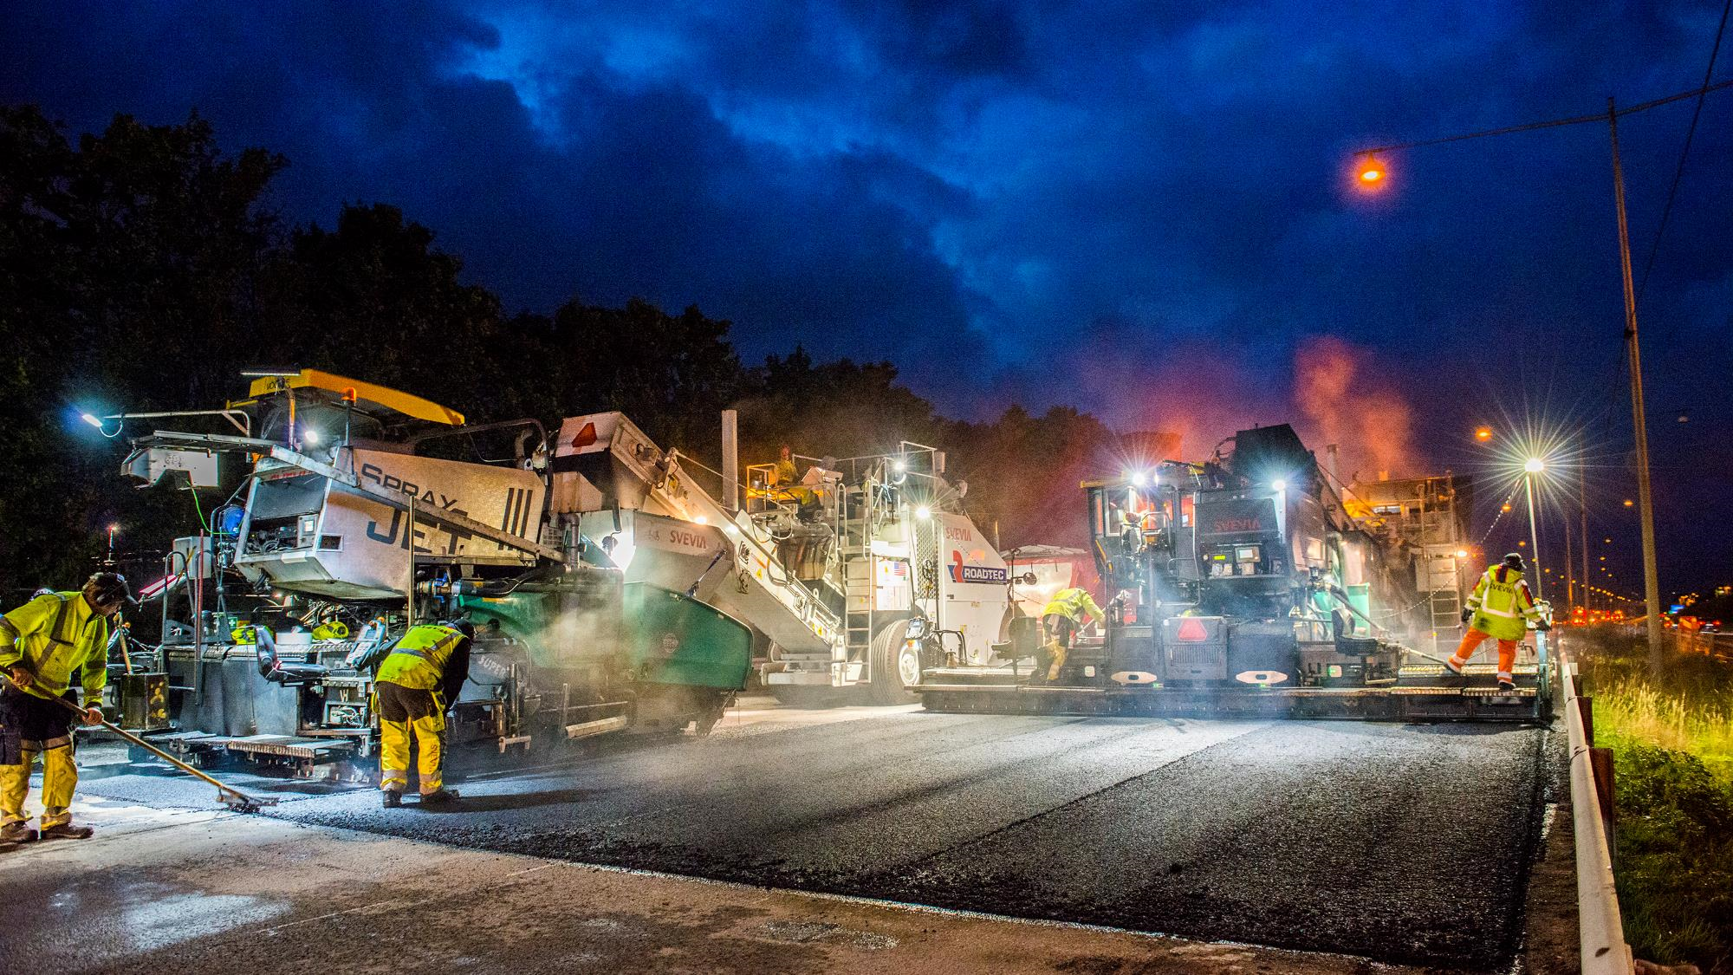
Tack för uppmärksamheten!
Contact information:
Fredrik Lindström, fredrik.lindstrom@trafikverket.se
Jan-Erik Lundmark, jan-erik.lundmark@trafikverket.se

